Slide 1
NeuroRadar: A Neuromorphic Radar Sensor for Low-Power IoT Systems
Kai Zheng, Kun Qian, Timothy Woodford, Xinyu Zhang
Electrical and Computer Engineering
Personal Page: https://kaizheng28.github.io
Notes:
Thanks for the introduction,

Slide 2
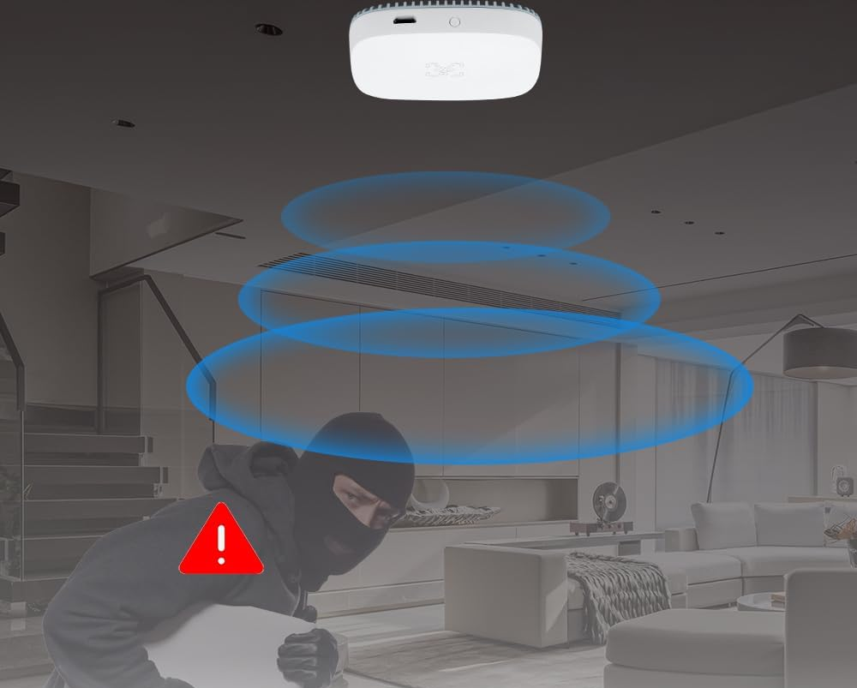
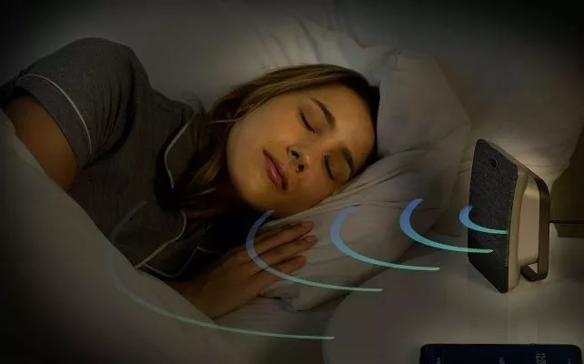
Radar Sensors for Internet of Things (IoTs)
By 2025, industrial radar > 10M devices.
Consumer radar market will reach $250M [1].
Non-Contact Sleep Monitoring
Presence Detection
Gesture Control
[1] Yole. 2020. Status of the Radar Industry: Players, Applications and Technology Trends 2020. (2020). https://www.yolegroup.com/product/report/status-of-theradar-industry-players-applications-and-technology-trends-2020/
Notes:
Radar sensors in the IoT systems have gained traction in recent years, with an increased number of applications.
Applications from radar sensors range from basic presence detection to more complicated gesture control and non-contact sleep monitoring

Slide 3
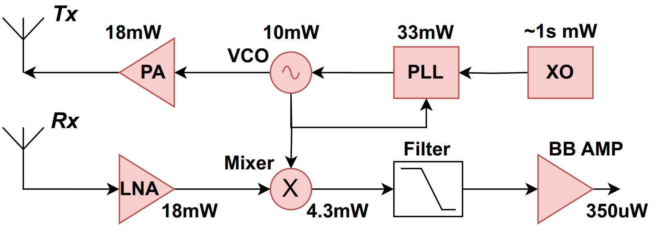
Challenges of IoT Radars
The high power consumption of radar systems remains a big challenge for battery-powered IoT devices.
Main sources of power consumption:
…
…
…
(1) Radar Front-End [1]
(2) Artificial Neural networks (ANNs)
Numerous RF components: 10s~100s mW
GPU/CPU: 10s~100s mW
[1] Ban Wang, Gabriele Tasselli, Cyril Botteron, and Pierre-André Farine. 2014. Building Blocks for a 24 GHz Phased-Array Front-End in CMOS Technology for Smart Streetlights. Progress In Electromagnetics Research B 61, ARTICLE (2014), 99–119.
Notes:
However, despite the rapid growth, the high power consumption of radar system remains a significant challenge, particularly for battery-operated IoT devices where energy efficiency and battery lifespan are crucial.
There are two main sources of power consumption.
The first one is the radar RF front-end.
The figure on the left shows the block diagram of a typical radar front-end. Due to the numerous RF components, the power consumption of the front-end ranges from 10s ~ 100s mW.
Secondly, in many applications, such as gesture recognition, artificial neural networks are often employed.
These neural networks are often run on GPU or CPUs, which can consume similar or even more power than the RF front-end.

Slide 4
Neuromorphic Computing
Spiking Neural Networks (SNNs): pulse-based ANNs.
 | Traditional ANNs | SNNs
Inter-neuron Communication
Information | Value | Timing / Density
Emulation | GPUs/CPUs | Neuromorphic computers
Architecture | Von-Neumann | In-memory computing
Computation | Synchronized | Asynchronized & event-based
Power | 1000x | 1x
2.5
0/1 Seq.
5.1
-0.8
Notes:
In order to reduce the energy consumption of the artificial neural networks, people have been looking into different computational models.
Recent advancements in neuromorphic computing have inspired the spiking neural networks.
Unlike traditional ANNs, which use continuous value for inter-neuron communication, SNNs use sparse binary sequences, or spikes, for communication.
The information is conveyed through the timing or the density of the spikes.
These pulse-based behavior highly mimics the neural systems in our brain.
Most traditional ANNs are emulated on GPUs and CPUs which follow the classic Von-neumann architecture, with the separated memory and computation units.
In contrary, SNNs are emulated on specialized neuromorphic computers that follow a non Von-Neumann, in-memory computing architecture.
In SNNs, each neuron and its synaptic connections represent an integrated memory and computation unit.
This architecture allows for massive parallelized computation, and circumvents the performance bottlenecks in Von-neumann computers.
The computation is event-based as a neuron in SNN remains idle until it receives spikes from other neurons. This feature makes SNNs highly energy-efficient.
As a result, SNNs can implement the same end-to-end functionality as ANNs but with orders of magnitude lower energy consumption.

Slide 5
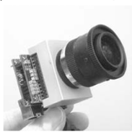
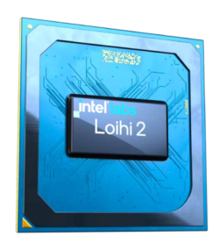
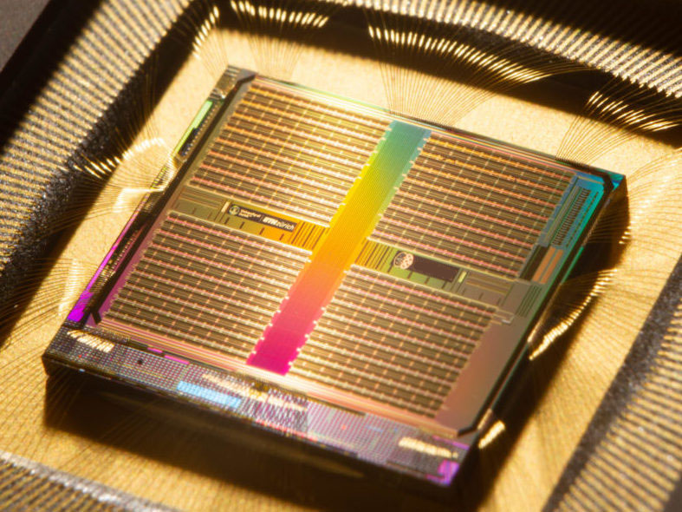
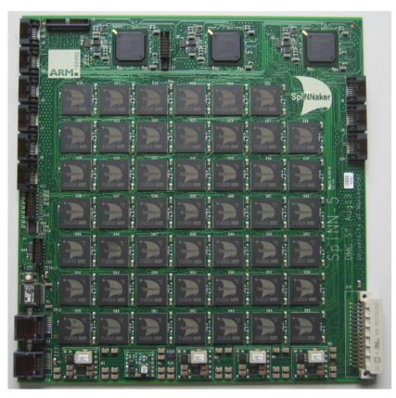
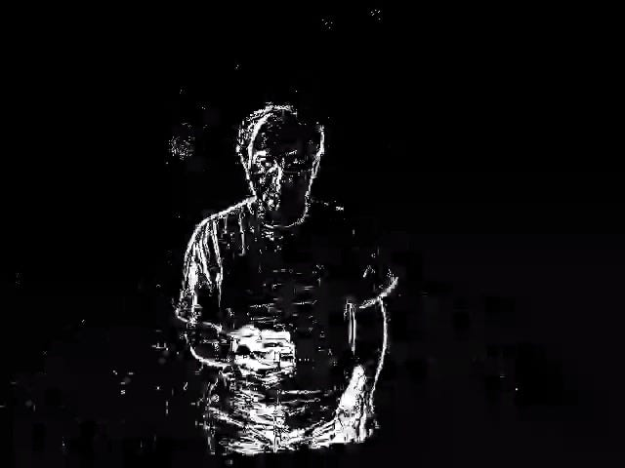
Neuromorphic Computer and Sensors
Neuromorphic computers: emulate 10s millions of spiking neurons on integrated circuits (IC).
Neuromorphic sensors: produce spike-based output; event-based sensing (the change of the environment).
Neuromorphic computers [1]
Neuromorphic sensors
Intel Loihi 2
U Zurich Dynap SE 2
U Manchester SpiNNaker
Dynamic Vision Sensor[2]
[1] A. R. Young, M. E. Dean, J. S. Plank and G. S. Rose, "A Review of Spiking Neuromorphic Hardware Communication Systems“.
[2] P. Lichtsteiner, C. Posch and T. Delbruck, "A 128x128 120 dB 15 us Latency Asynchronous Temporal Contrast Vision Sensor"
Notes:
Recent years, researchers have developed neuromorphic computers that can emulate 10s ….
Examples include Intel Loihi, Dynap SE, and SpiNNaker.
Inspired by the concepts in neuromorphic engineering, researchers have also developed neuromorphic sensors that directly produce spike-based readout.
These sensors perform an event-based sensing, only reacting to the change of the environment.
One example is the well-known dynamic vision sensor or event camera.
Instead of producing frames on a fixed rate, event cameras only react to the change of the brightness of pixels, and produce sequences of spikes.
This enables them to attain a high temporal resolution, high dynamic range and low power consumption.
High pixel bandwidth (kHz)

Slide 6
Can we bring neuromorphic computing/sensing into the RF domain?
Notes:
So, can we bring neuromorphic computing/sensing into the RF domain, and build low-power radar systems?

Slide 7
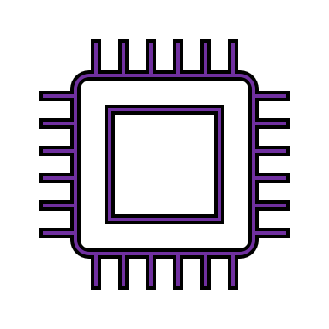
Related Work
ANNs
Existing “SNN Radars”:
ADC
Preprocess (FFTs/Filtering)
Spike Encoding
…
…
RF Front-End
…
10s~100s mW
Digital sampling/processing: 1s~10s mW
10s~100s uW
SNNs
10s~100s mW
Dominates the power consumption!
NeuroRadar:
~
Low-Profile Radar Front-end
Analog Spike Encoder
SNNs
0.1~1 mW
~1s uW
10s~100s uW
Notes:
Let’s first take a look at the existing radar sensing paradigm. The RF front-end first senses the environment and the radar baseband signal is sampled by analog-to-digital converters.
After getting the raw radar samples, the next step is usually to preprocess them by performing FFTs and/or different kinds of filtering. Lastly, the intermediate data is sent into ANNs which have been trained for different tasks.
There are existing “SNN radars” that replace the ANNs with SNNs. As SNNs can only process spike-based input, a spike encoding block is added to map the real values into spike sequences. This encoding is mainly done in software.
Although replacing traditional ANNs with SNNs significantly reduces the power consumption, this paradigm faces several limitations.
Firstly, the RF front-end remains unchanged. It is still consuming relatively high power.
Secondly, the radar signal preprocessing still relies on von-Neumann computers. They are NOT neuromorphic and the digital sampling and processing adds significant overhead. As the first two block dominates the power consumption, the benefit of using SNNs is less significant.
To address this issues, we introduce NEURORADAR, a novel low-power radar sensing system that fully exploits the power of neuromorphic sensing and computing.
Firstly, we design a low-profile radar front-end with a minimum power consumption. The front-end is designed in a way that the baseband siganl can be directly encoded into spikes using analog spike encoder circuits. These spikes can directly interface with the energy-efficient SNNs.
The end-to-end power consumption is, therefore, orders of magnitude lower than existing SNN radar systems.
Next, I will briefly go over each part of the system.

Slide 8
Low-Profile Radar Front-End
Self-Injection Locking (SIL)
$$f_{1}$$
$$f_{2}$$
~
(a) Traditional CW radar[1]
Reflector
Oscillator
Motion modulates osc. frequency.
Demodulated into a voltage signal at baseband.
(b) SIL radar
[1] Ban Wang, Gabriele Tasselli, Cyril Botteron, and Pierre-André Farine. 2014. Building Blocks for a 24 GHz Phased-Array Front-End in CMOS Technology for Smart Streetlights. Progress In Electromagnetics Research B 61, ARTICLE (2014), 99–119.
Notes:
The high power consumption of radar front-end stems from the numerous RF components. Here we design a simplified, low-profile radar sensor by removing most of the RF components.
The only active RF component remains is a free-running oscillator, which is directly connected to an antenna.
NeuroRadar senses the environment using the self-injection locking principle.
SIL is a phenomenon that the frequency of a free-running oscillator is affected by the motion of the reflectors in the vicinity. As the target moves, the frequency of the oscillator changes accordingly.
The frequency shift can be demodulated into a voltage signal for next-stage processing.
SIL radar provides a demodulation gain that enhances the motion signal and allows the sensor to maintain a reasonable sensitivity even without amplifiers.

Slide 9
An Array of SIL Sensors
Limitation:
Only detects motion.
No absolute range information.
No angular information.
Solution: employ an array of SIL sensors with distinctive frequencies.
…
~
~
~
~
$$f_{1}$$
$$f_{2}$$
$$f_{3}$$
$$f_{k}$$
Notes:
SIL radars are not without limitations. As they can only detect motion, it provides no absolute range information.
Also, a single sensor also gives no angular information.
To address this issue, we draw inspiration from the compound structures found in certain biological sensing organs, such as our eyes/ears, and employ an array of SIL sensors with distinctive frequencies.
This setup provides a much richer information and allows for more advanced applications.

Slide 10
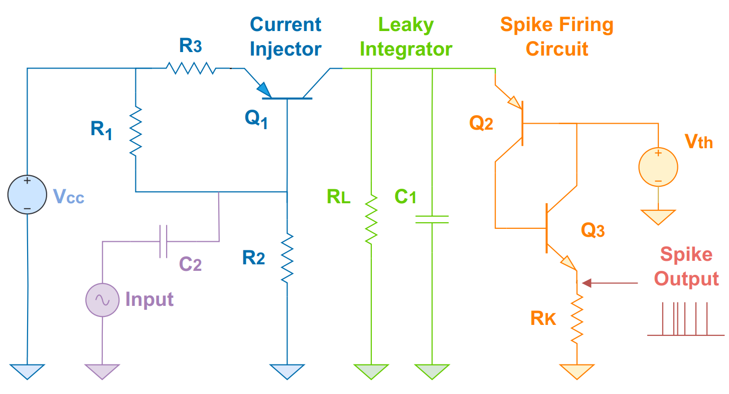
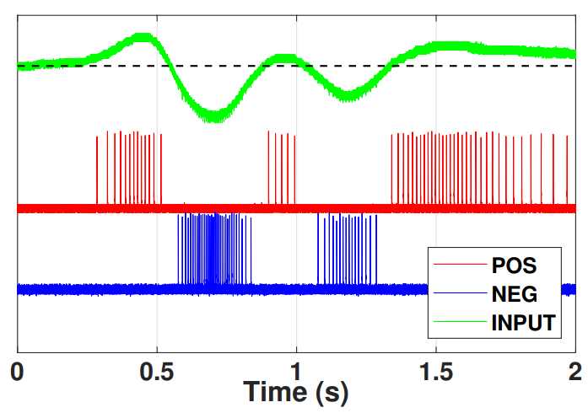
Spike Encoder
Encode the motion information into the spike sequences.
Spike rate encoding.
1 sensor → 2 spike channels (+/-).
(b) Spike representation of a continuous signal
(a) Spike encoder (asynchronous)
Notes:
The next part of the system is the spike encoder, which encodes the demodulated motion signal directly into spike sequences.
The circuit essentially performs spike rate encoding, where the density of the spikes represent the signal strength.
The circuit is asynchronous without any clock signal. The input signal is AC coupled and two spike channels are used to represent the input signal.
One represents the positive part and the other represents the negative part, as shown in the figure on the right.
The design ensures event-based output. When there is no motion in the surrounding area, the sensor produces no spikes.
the leaky-integrate-and-Fire neuron model

Slide 11
SNN Design
0.1
Linear
0.7
0.2
Input
Buffering
Conv. Layers
Decoder
Result
Flatten the spikes sequences, facilitates processing
Extract spatiotemporal features
Interpret the spike-based output
Notes:
The SNNs designed in our work follows the general structure like this. The input spikes first enter the spike buffering unit, which flattens the spike sequences, which facilitates future processing.
The next block is the convolutional layers that extracts the spatiotemporal features of the spikes.
The last block is the spike decoding block which aims to interpret the spike output and map them to real values.

Slide 12
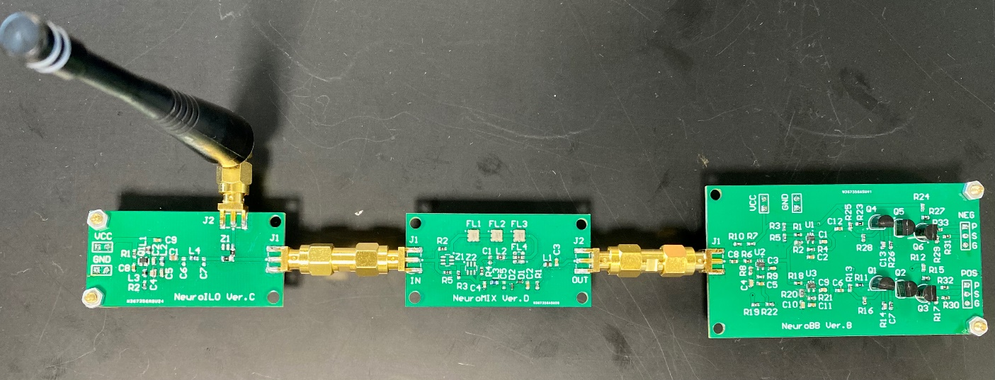
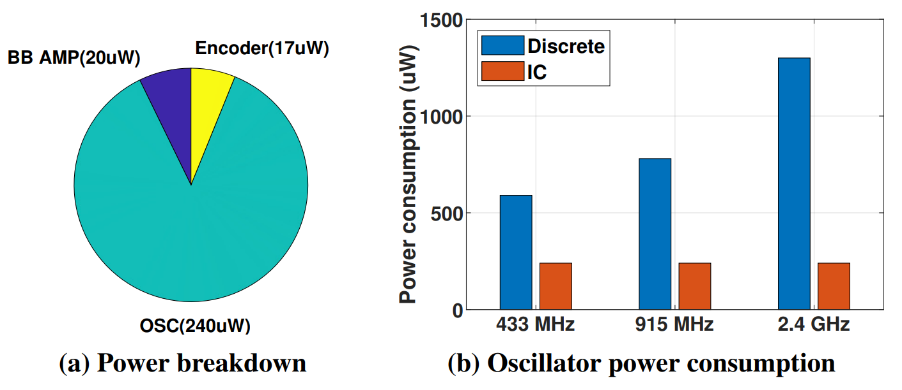
Implementation
Implemented using discrete components on PCB.
Simulated the IC version using 90nm PDK.
SNN emulated on Intel Loihi using Nengo-DL.
Total power consumption <300uW for single sensor.
Frequency band <3GHz.
Antenna
Delay and Mixing Circuit
Amplifiers and Spike Encoders
SIL Oscillator
Notes:
We implemented the system using discrete components on PCB, and simulated the IC version using a 90nm PDK.
The SNNs are emulated on Intel Loihi using the Nengo-DL framework.
The total power consumption of the system falls below 300uW. And the sensors can work at any frequencies below 3GHz.

Slide 13
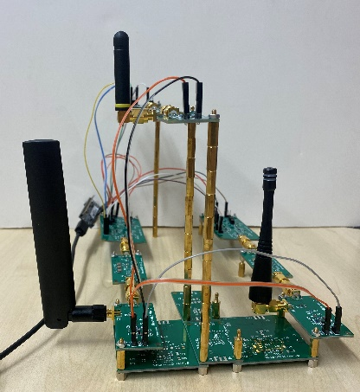
Case Study I: Gesture Recognition
(1) Swipe Right
(2) Swipe Left
(3) Swipe Up
(4) Swipe Down
(5) Push
(6) Pull
(7) Clockwise
(8) Counter-clockwise
(9) Open Hands
(10) Close Hands
(11) Worship
(12) Wrist Rotation
3-sensor setup (6 spike channels), 12 gestures.
2400 samples collected (200 each), each gesture sample has a length of 1.5s.
Notes:
NeuroRadar can support a variety of applications. Here we demonstrate two case studies. The first one is gesture recognition.
We employ a 3-sensor setup which results in 6 spike channels. We designed 12 gestures and collected 2400 samples, 200 each.
Each sample is a spike sequence with a length of 1.5s.
We use a 80/20 split for training and test.

Slide 14
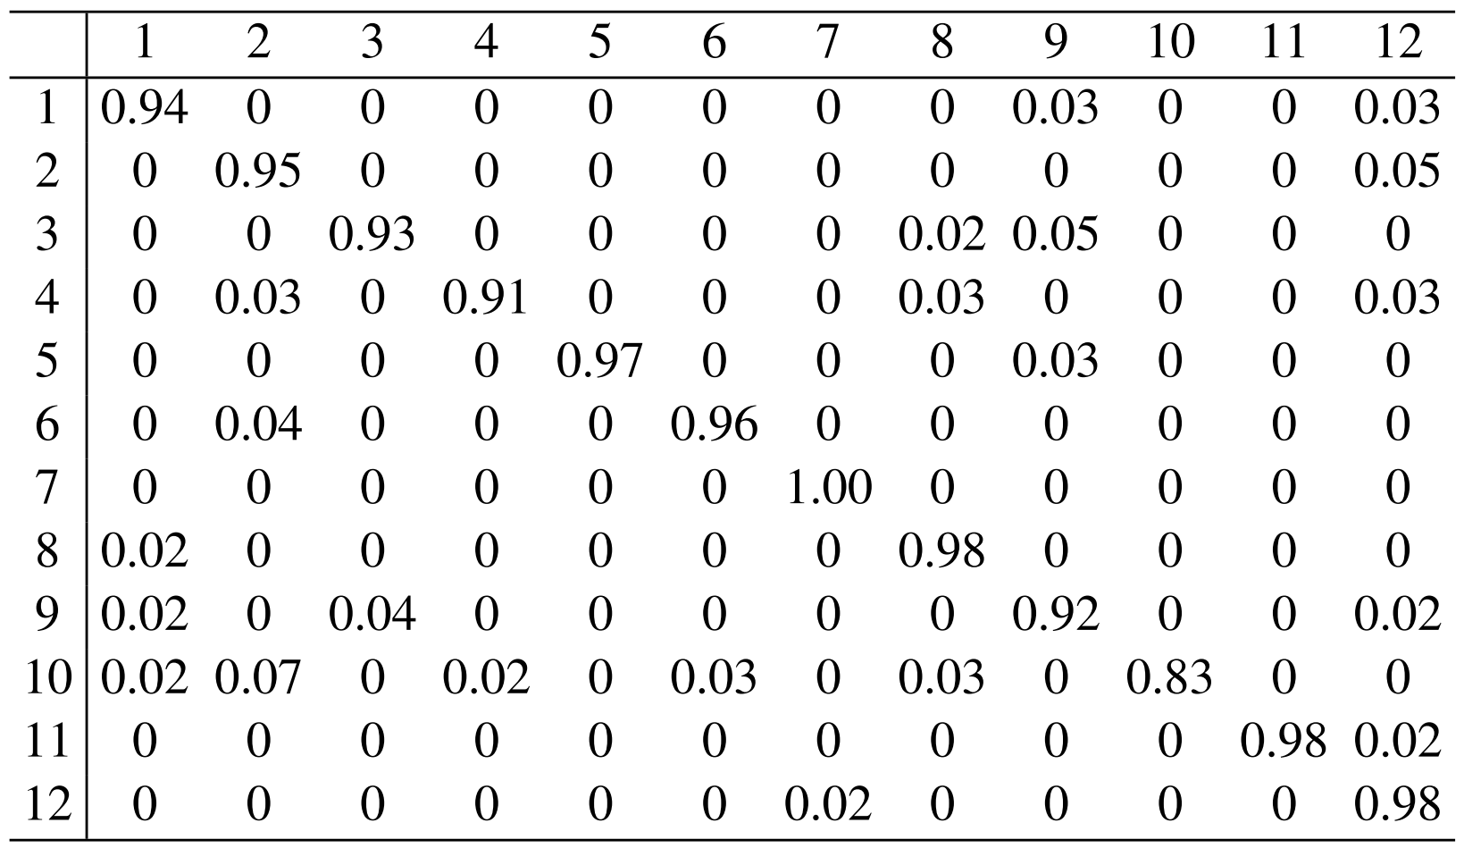
Case Study I: Gesture Recognition
Confusion matrix
Accuracy = 94.58%
Latency = 80ms
P_front-end = 830uW.
P_SNN = 65uW.
Similar accuracy and # gestures, but:
78-93% power consumption reduction compared with other “SNN radars”

Slide 15
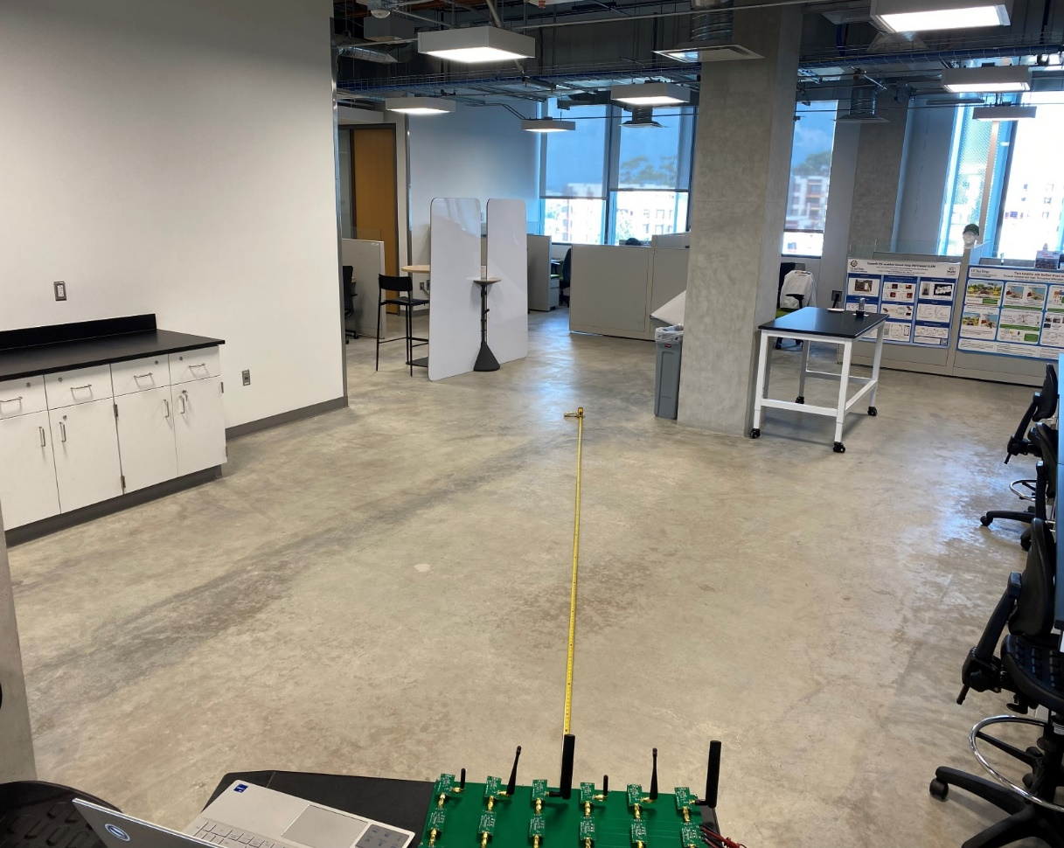
Case Study II: Localization / Tracking
6-sensor setup (12 spike channels).
Single volunteer walking around in the designed area.
Collected a total of 3600-sec spike data (ground truth from a depth camera).
Divided into 2s short frames for training/testing.
1.80m
2.70m
3.50m
6.00m
5.20m
3.90m

Slide 16
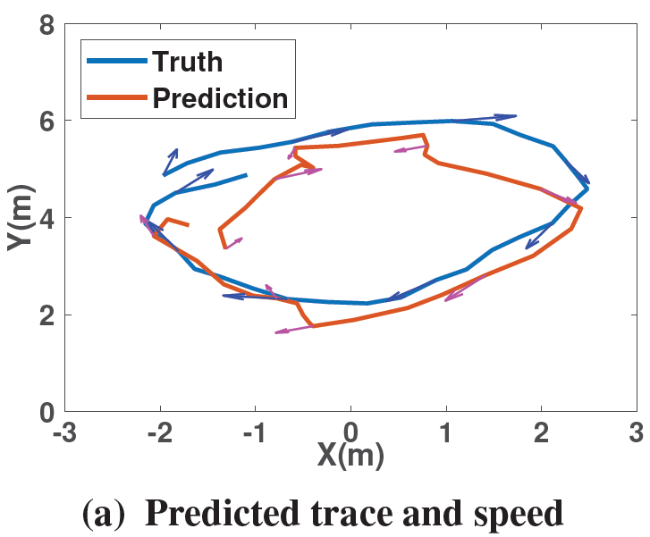
Case Study II: Localization / Tracking
Localization error: ~1m
Speed mse: 0.25$m^{2}/s^{2}$
Latency = 150ms
P_front-end = 1.44mW.
P_SNN = 0.59mW.
97% reduction of power consumption compared to a traditional radar system [1].
[1] Avinash Kalyanaraman, Elahe Soltanaghaei, and Kamin Whitehouse. 2019. Doorpler: A radar-based system for real-time, low power zone occupancy sensing. In 2019 IEEE Real-Time and Embedded Technology and Applications Symposium (RTAS). IEEE, 42–53.

Slide 17
Conclusion
NeuroRadar: a novel radar sensing paradigm that fully the embraces the concepts in neuromorphic engineering.
Joint design of analog front-end and SNNs: NeuroRadar achieves superior energy efficiency.
An innovative solution for radar sensing in energy constrained IoT devices!

